Slide 1
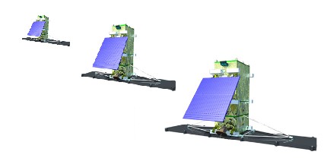
ISO/TS 19159-4 Calibration and validation of remote sensing imagery sensors — Part 4: Space-borne microwave radiometers
1
2
3
Zoom Virtual Meeting
27, May 2021, 9:00 am Eastern Time, 11:00 UTC

Slide 2
Outlines
Status of the Project: Timeline
Status of the Project: Background
Status of the Project: Updates since last plenary meeting
Next Steps

Slide 3

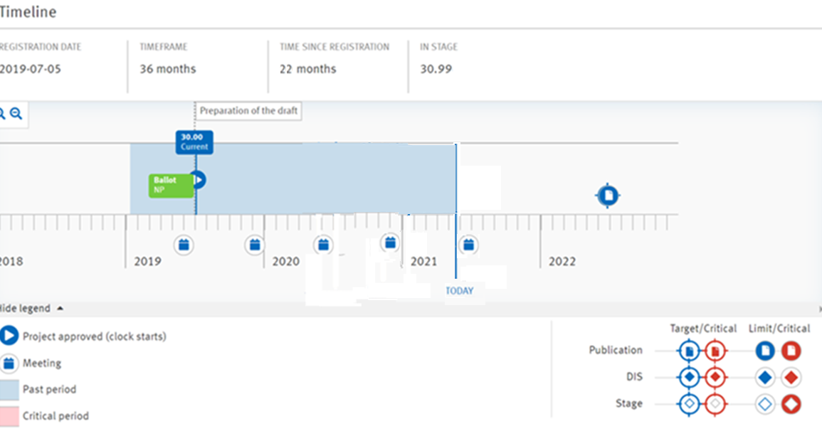
Status of Project: Timeline
ISO/TS 19159-4 Calibration and validation of remote sensing imagery sensors — Part 4: Space-borne microwave radiometers
Submit for DTS ballot
Aug. 17, 2020
Get DTS ballot result
Oct. 12, 2020
TS Published by July 2 2022
52nd Plenary
Week (June 7 ~ 11) 2021
Editing meeting
Nov. 24, 2020
51st Plenary
Week (Nov. 30 ~ Dec. 4) 2020

Slide 4
Status of Project: Background
Editing meeting has been held on Nov. 24, 2020.
3 comments received during the DTS ballot: 2 from GBR, 1 from Japan.
After the DTS ballot, 28 comments received in mid-Nov. from Canada (Tobias Spears from XMG) mostly on the class diagrams, UML model and data dictionary.
Comments received from TMG (Reese Plews) on the terms.

Slide 5
Status of Project: Updates since last plenary meeting
Term definitions have been modified in Jan. and Feb. 2021.
Data dictionary were significantly enriched in Mar. ~May. 2021. Very few modifications are made in the main text to keep accordance with the data dictionary .

Slide 6
Status of Project: Updates Dec. 2020~ Mar. 2021
Two meeting were held to deal with the issues on terms (Jan. 21 & Jan. 29, 2021).
The latest draft, Version 2.5 has been written along with a merging file containing all the response to the comments since the DTS Ballot, which were dispatched on Feb. 16, 2021.
The UML diagrams were redesigned using EA tool, and the xsd file was regenerated using Shapechange tool and validated using xmlspy tool. The files were submitted on Mar. 1, 2021.

Slide 7
Status of Project: Updates Apr. 2021~ May 2021
The data dictionary are checked item by item, and the definitions has been expanded. The data dictionary is rearranged in the alphabet order.
“bandResponseFunction”s →“spectralResponseFunction”s, and shifted from CA_AuxilaryData to CA_TACalibration.
DataType: Real[0..1]→ Real[2] (item 25); Real[0..2]→ Real[3] (item 30)
“microwaveRadiometerObservationInterval” → “microwaveRadiometerSamplingInterval” (item 55)
The “atmosphereMoisture” is replaced by “atmosphereHumidity” (item 55)
“atmosphereMoisture” →“atmosphereHumidity” (item 119)
“oceanSurfaceRoughness” →“oceanSignificantWaveHeight” (item 125)
“rainAbnormal” in codelist (item 36) is deleted.
The upper limit of the TB attributes is set as 330K.
Unit of frequency: “Hz” → “GHz”.
Sample data are provided for almost all the attributes in the classes. The corresponding xml data are generated. All the data are physically meaningful and can help experts from microwave radiometer community understand and implement the model.

Slide 8
Next step
i. Completely finalize the data dictionary, and send a copy of the finalized document to Tobias when complete.
ii. Check the sample xml files with Tobias.
iii. After sending (i) and (ii), invite Tobias to ensure UML and data dictionary consistencies, and xml is in order.

Slide 9

Thank You

